Slide 1
Induction
Version 8.85
Kahoot included

Slide 2
??? ok but what is induction ???

Slide 3
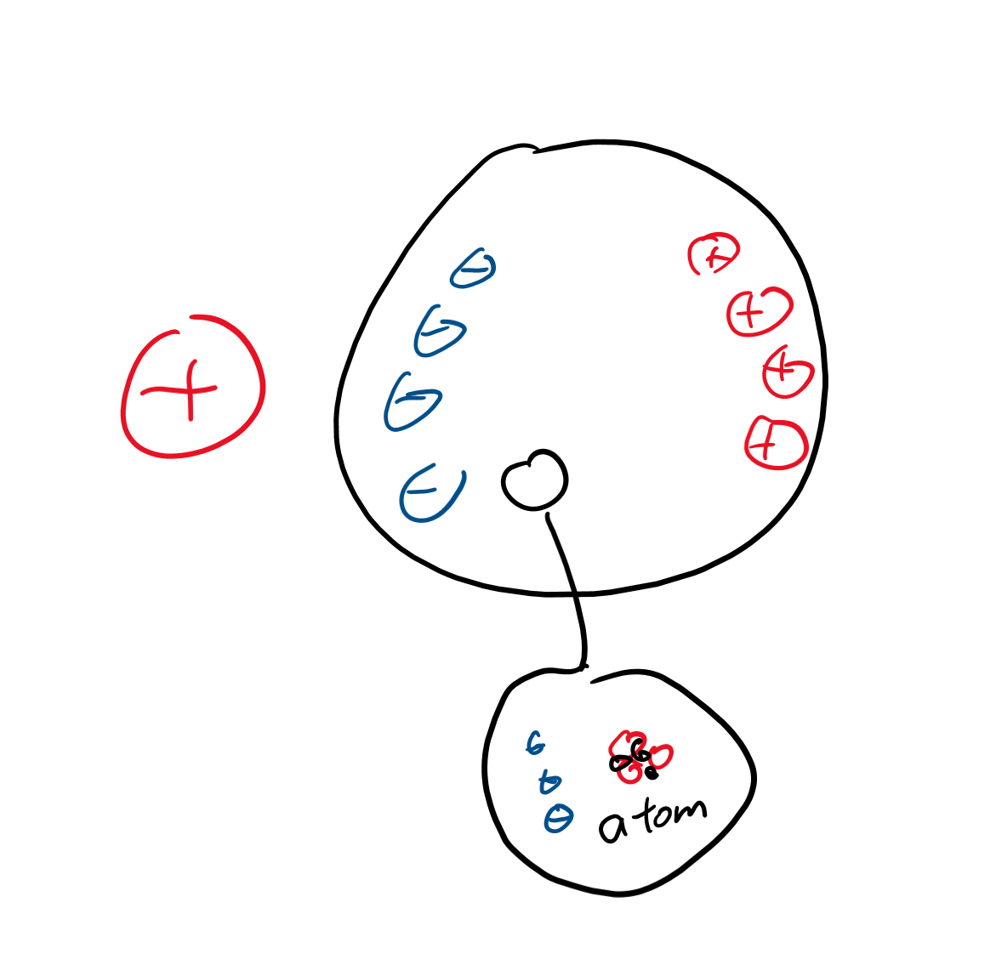
Opposites attract
If you move a positive charge near a neutral particle, the particle’s charges will separate.
The electrons will go toward the positive charge.
The protons will be on the other side.

Slide 4
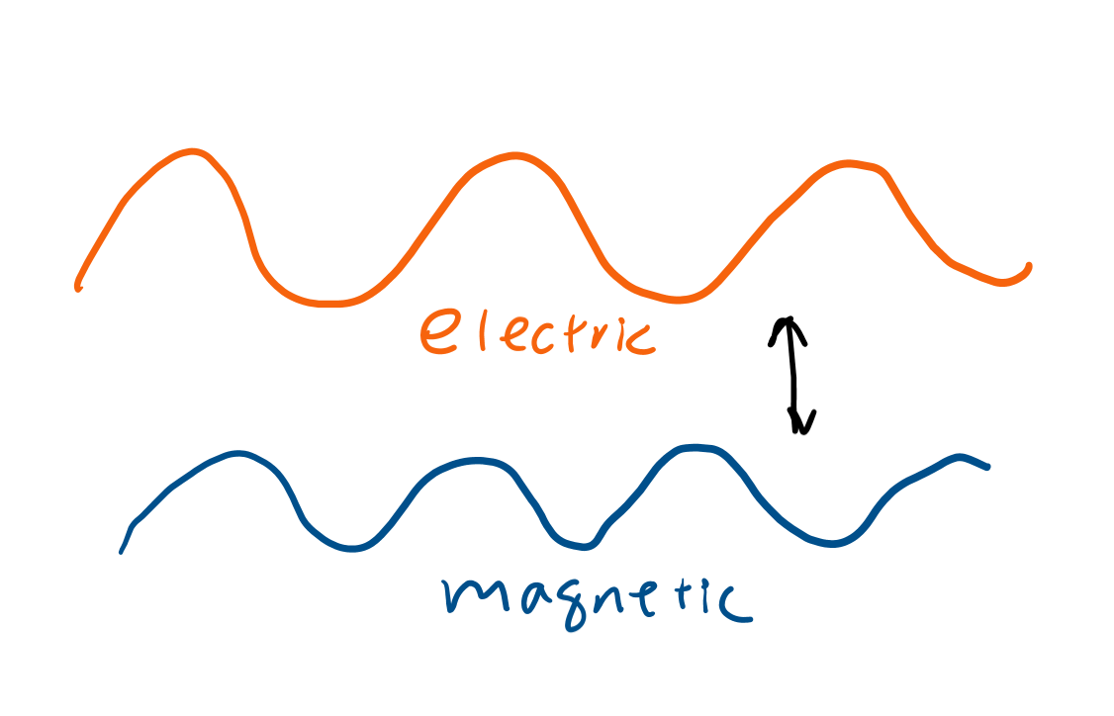
Induction? o.O
The idea that one thing can cause another thing to appear.
If you have an electric charge, you can induce a charge in another object.
If you have an electric field, you can also induce a magnetic one and vice versa.

Slide 5
Electromagnetism

Slide 6
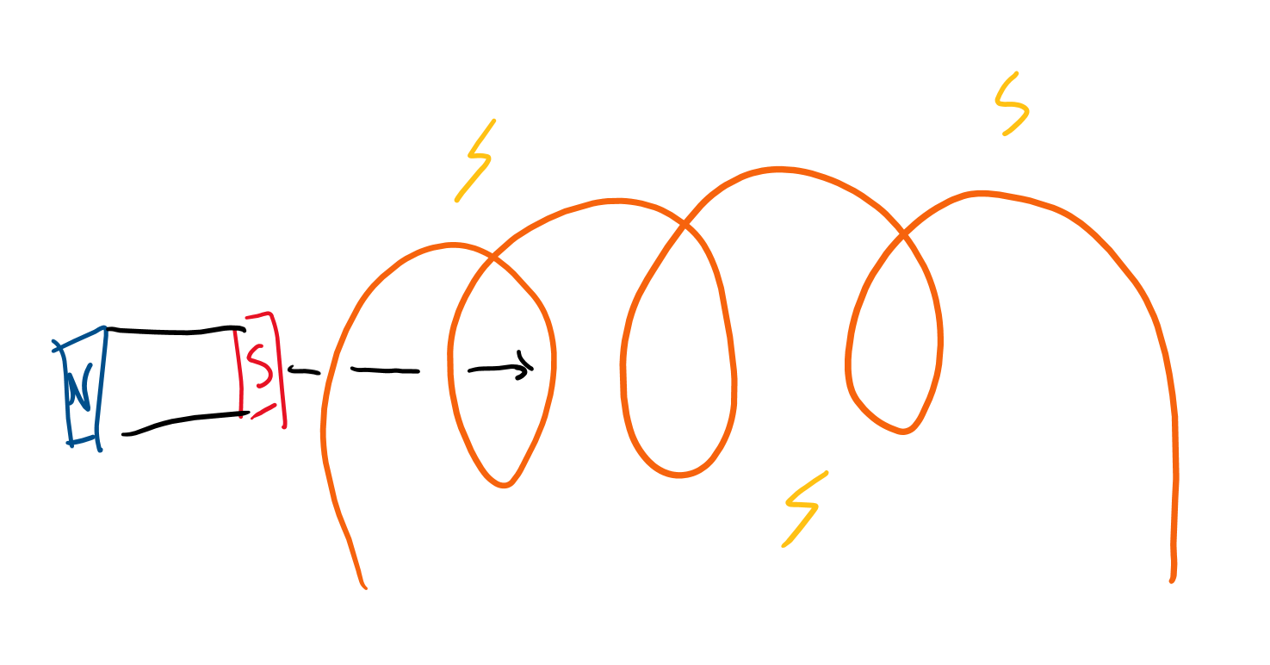
If you move a magnet through a wire what happens?
You have a moving magnetic field.
This causes a current to be made.

Slide 7
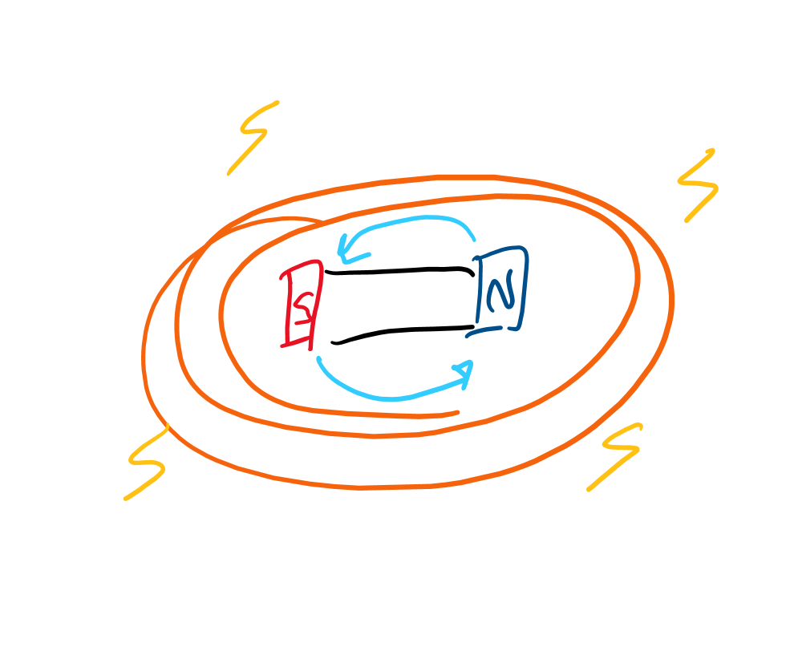
Where do we see induction?
Generators:
You spin a magnet around.
What happens to the magnetic field?
So what’s going to happen to the current?

Slide 8
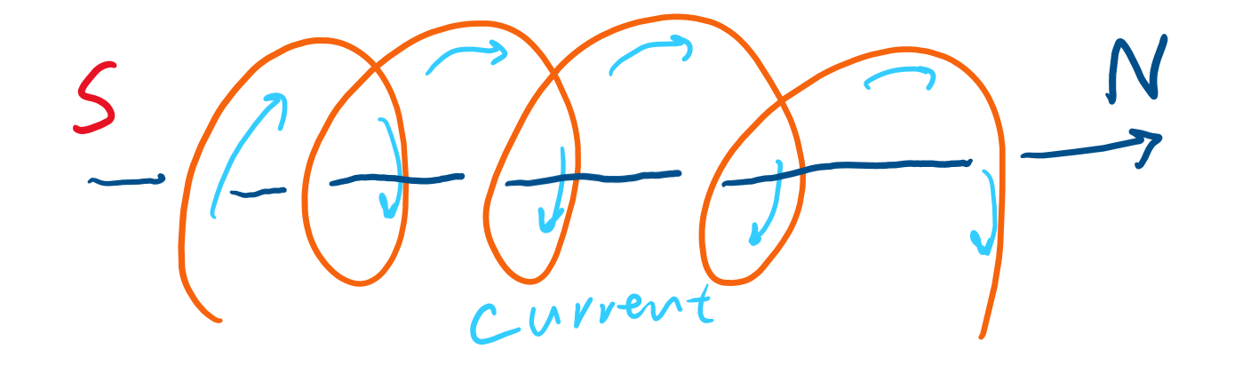
What about near a current?
When there’s a current, charges are moving, and that means we also “induce” a magnetic field.

Slide 9
Energy

Slide 10
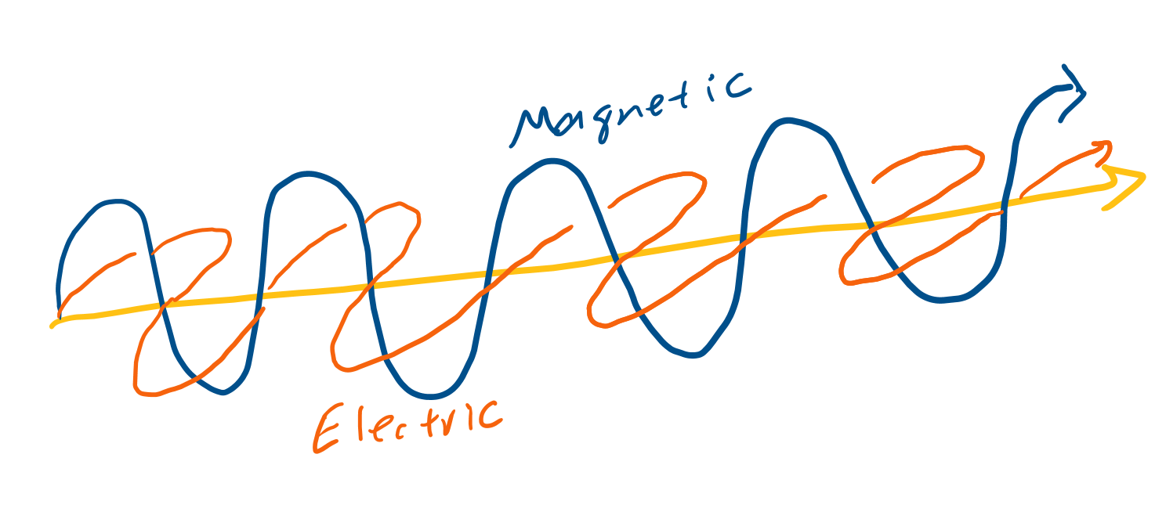
In nature
Electromagnetic waves:
Light is one.
These waves are actually two waves, a magnetic one and a electric one.
They don’t need a medium because they create their own medium: electric waves create magnetic which create electric and back and forth like that.

Slide 11
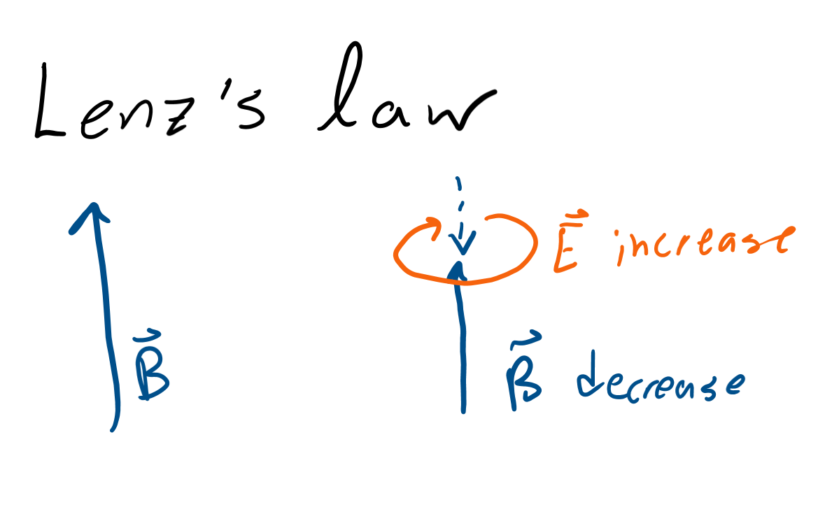
Conservation of energy?
If electric fields are making magnetic ones and the other way too, why aren’t they everywhere?
If you have a magnetic field, you need to convert some of that magnetic field to electric, so you end up with a weaker magnetic field.
Think of it like potential and kinetic energies. If you have magnetic field, you can convert to electric by taking away some magnetic.

